Slide 1
Logistic Regression Model Kaiyao Qin

Slide 2
Loan Risk Model Predict …
Who, amongst existing loan customers, are more likely to be default (bad)?
Existing Loan Customers
At the month
of 18
Good accounts
Definition of Default (bad):
An account that was in NPNA or DWO or
90+ delinquent status as at the month 18.
Bad accounts

Slide 3
Methodology and Data Partition
Methodology -- Logistic Regression
Calibration Sample
Validation Sample
Sampling Population
Random Sample of 60%
Random Sample of 40%

Slide 4
Modeling Process
Modeling data set has
more than 50 independent variables, and
one dependent binary variable: bad=1, non-bad=0.
Preliminary variable transformations through Rank & Plot.
Logistic Regression
logit(P / (1-P))= α + β₁x₁ + β₂x₂ + ... + β_{N}x_{N}, using stepwise
selection technique
Correlation between variables, model concordance and goodness-of-fit are used to select the best-fit model

Slide 5
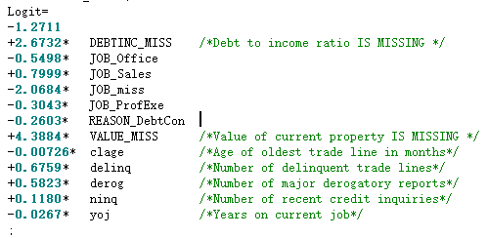
Model Result: Logit Equation
Drivers
CF with + is positive driver
Suppressors
CF with – is negative driver

Slide 6
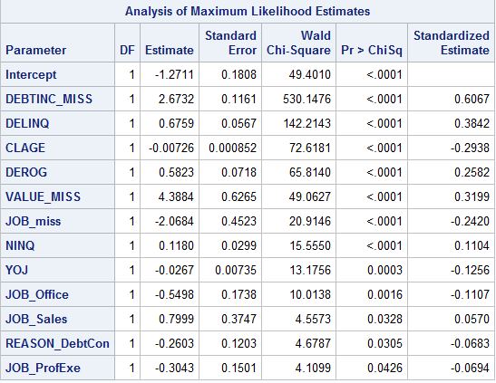
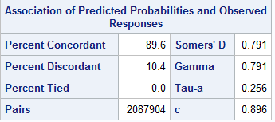
Summary of Model Results

Slide 7
Model Validation Process
To ensure model performs well on future unseen data, model is tested on both the validation data and whole file data.
The validation data set is not used for model development.
KS-Test (Kolmogorov Smirnov Statistics) algorithm is used for model validation. The result is based on Maximum-KS, observed lift value, and smoothness of the lift curve.

Slide 8
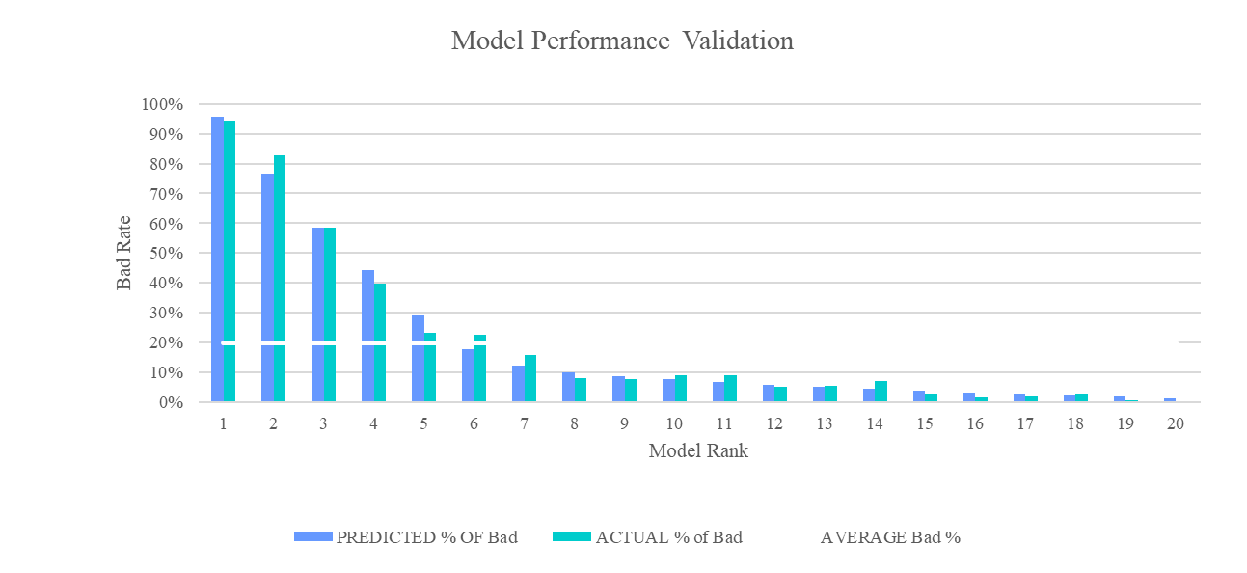
Model Validation
The predicted bad rate in top quantile is 96.4%, compare to an average of 19.5% based on the whole file. The model results a lift of almost 5 in the top quantile.

Slide 9
Validation - KS-Test Chart
The diagonal line illustrates the
number of bad expected
from a randomly selected target
audience.
The top curve represents the
expected bad if the
model scores determine the
target audience.
79% of successes are captured by the top 25% of the file.

Slide 10
Comments and Recommendations
The performance of the model is good. The logistic model Concordance Rate is reasonable(89%), and the variables entered into the final regressions make business sense.
Max_KS (0.50) is attained at 25% of the ranked file, meaning that at this point, we capture the highest proportion of bad and the lowest proportion of good.
The model results are presented in very simple fashion by model score which is assigned to selected customers. This score is from 0 to 1, 1 being the certainty of bad, 0 being the opposite.

